Slide 1
Introduction to Tableau

Slide 2
Introduction
Tableau is a Business Intelligence tool used to analyze data visually. Using Tableau, users can create shareable and interactive dashboards that show trends and variations in the form of graphs and charts. It can connect to files, big data, and relational sources to obtain data and process them, all at great ease.

Slide 3
What makes Tableau great?
· No prior technical knowledge is needed.
· Connection to all kinds of data sources including MS Excel, web data, and warehouses is possible.
· It can produce interactive and visual presentations within seconds rather than months and years.
· The data visualization helps in business growth and profits.
· It provides good business insights.
· It is simple and easy to study and operate because of the simple drag and drop interface.

Slide 4
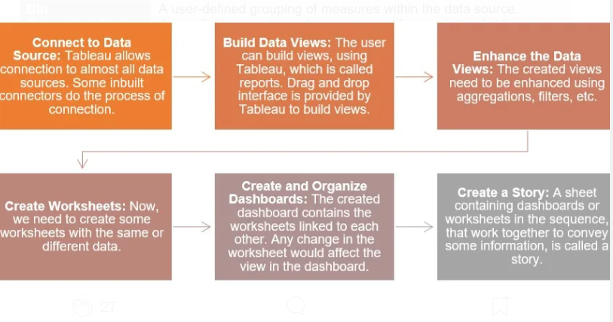
Design Flow

Slide 5
Tableau Products
Tableau offers several products tailored to different user needs and roles within organizations. Here's a list of some of the key Tableau products along with their differences:
Tableau Desktop: Tableau Desktop is the primary data visualization tool for creating interactive dashboards and visualizations. It is designed for individual analysts and data professionals who need to create, analyze, and share insights from data.
Tableau Server: Tableau Server is an enterprise-grade platform for sharing and collaborating on Tableau dashboards and visualizations. It allows users to publish Tableau workbooks and data sources to a centralized server, making them accessible to authorized users via a web browser or mobile device.
3. Tableau Online: Tableau Online is a cloud-based version of Tableau Server hosted and managed by Tableau. It offers similar functionality to Tableau Server, including the ability to publish, share, and collaborate on Tableau content.
4. Tableau Prep: Tableau Prep is a data preparation tool designed to clean, shape, and transform data before analysis. It helps users streamline the data preparation process and ensure that data is ready for analysis in Tableau Desktop or Tableau Server.
5. Tableau Public: is a free version of Tableau Desktop that allows users to create and share visualizations publicly on the web. It is intended for personal and non-commercial use, and visualizations created with Tableau Public are accessible to anyone. It is a great option for students, and enthusiasts who want to showcase their data visualization skills and collaborate with the Tableau community.

Slide 6
Data Types and Terms
Enhancing your presentation

Slide 7
Data Terms
In Tableau, an alias refers to an alternate name given to a field or dimension within a data source. This feature allows users to assign a different label or name to a field without altering the original data. Aliases are particularly useful when you want to present data with more meaningful or understandable labels in your visualizations, dashboards, or reports.
For example, if a field in your dataset is labeled "Region," but you prefer to display it as "Sales Region" in your visualizations, you can create an alias for the "Region" field and rename it as "Sales Region." This change will only affect how the field is displayed in Tableau, while the underlying data remains unchanged.
Creating aliases can improve the clarity and relevance of your visualizations, making it easier for users to interpret the data presented. Additionally, aliases can be dynamically updated and managed within Tableau as needed, providing flexibility in data presentation.
Alias

Slide 8
Data Terms
In Tableau, bins are used to group numeric data into discrete intervals or ranges. Bins allow you to categorize continuous data, such as ages, prices, or quantities, into predefined intervals or "bins." This is particularly useful for creating histograms, understanding distribution patterns, and analyzing data at a higher level of abstraction.
Bins

Slide 9
Data Terms
In Tableau, a calculated field is a user-defined field that is created by applying a formula or calculation to existing fields in your data source. Calculated fields allow you to perform calculations, manipulate data, and generate new insights based on your specific requirements. You can use calculated fields to perform a wide range of operations, including mathematical calculations, logical comparisons, string manipulations, and date/time calculations.
Calculated Field

Slide 10
Data Terms
A crosstab, short for "cross-tabulation," is a type of table in Tableau that displays the intersection of two or more dimensions or measures in a grid format. It provides a compact and organized way to compare data across different categories or dimensions.
Crosstab

Slide 11
Data Types
Data Type | Description
String | a data type used to represent a sequence of characters, typically used to store and manipulate text
Number | a data type that represents numeric values. Numbers can be integers (whole numbers) or floating-point numbers (decimal numbers)
Boolean | Logical values: True or False
Date and Datetime | data types used in programming to represent dates and times

Slide 12
Setting Up Tableau Public
Tableau Download: https://www.tableau.com/products/public/download
Data download: https://www.kaggle.com/datasets/gregorut/videogamesales?resource=download

Slide 13
Exercises

Slide 14
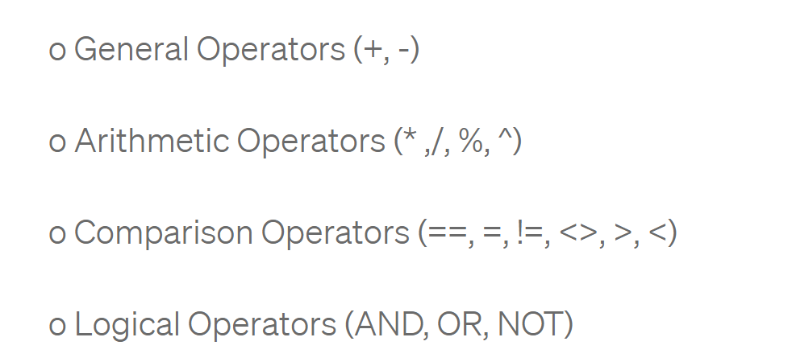
How to use Calculated Fields and Bins in Tableau

Slide 15
Thank you

